Slide 1
Antibacterials (Antibiotics)
Please, help me and concentrate from the first moment to the end

Slide 2
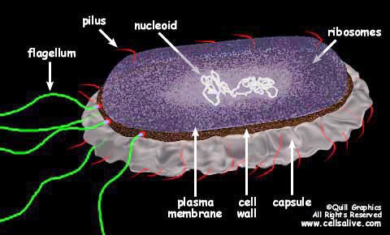
Introduction
    Antibiotics are compounds (either natural or synthetic) that inhibit the growth and survival of microorganisms without serious toxicity to the host
    Antibiotics are amongst the most frequently prescribed medications today
    Antimicrobial resistance is becoming a serious issue, due to either misuse, overuse, or genetic changes in microorganisms

Slide 3
Bacteria & Antibacterials
    Antibacterial agents can be classified as being either bacteriocidal (they kill bacteria) or bacteriostatic (they disrupt the growth cycle)
    Whilst bacteriocidal is better, for some drugs (e.g. tetracycline) the clinical dosage required to be bacteriocidal is too high, so it is considered to be bacteriostatic
    Bacteria rapidly develop resistance to a drug, often involving a change in the bacterium's biochemistry
    Bacteria are classified either as gram positive or gram negative

Slide 4
Mechanisms of Antibacterial Agents
Principally, current antibacterial agents act by one of the following mechanisms:
  Inhibition of bacterial cell wall synthesis (β-lactams)➔ (Penicillines) (Cephalosporines)
  Disruption of protein synthesis (Inhibitors of protein synthesis) ➔ (Macrolides, Tertacyclines, Aminoglycosides)
  Inhibition of cell metabolism (Antimetabolites) ➔ (Sulfonamides) (Pyrimidines)
  Inhibition of nucleic acid transcription / replication (Inhibit DNA replication) ➔ (topoisomerase II or Gyrase) ➔ (Quinolones)

Slide 5
Inhibitors of Bacterial Cell Wall Biosynthesis
The β-lactams
  Penicillins
  β-lactamase inhibitors (special case!)
  Cephalosporins
  Monobactams

Slide 6
Inhibitors of Bacterial Cell Wall Biosynthesis
    The bacterial cell wall is significantly different in structure and function compared to the outer layer of mammalian cells
    The bacterial cell wall is chemically different from mammalian cells, and is therefore constructed by enzymes that often have no mammalian counterpart
    There are three distinct functions of the bacterial cell wall
  Providing a semi-permeable barrier that allows only "desirable" substances to pass
  Providing a sufficiently strong barrier so that the bacterial cell is protected from changes in osmotic pressure of its environment
  To prevent digestion by host enzymes

Slide 7
Inhibitors of Bacterial Cell Wall Biosynthesis
Penicillins

Slide 8
Structure of β-Lactam
    The name lactam is given to cyclic amide, cyclic ester called lactone
    Beta-lactam is a cyclic amide with four atoms in its ring
  This structure system found to be the feature of the structure of the penicillins and cephalosporins

Slide 9

Structure Activity Relationship
Conclusions
Amide and carboxylic acid are involved in binding
Carboxylic acid binds as the carboxylate ion
Mechanism of action involves the β-lactam ring
Activity related to β-lactam ring strain
(subject to stability factors)
Bicyclic system increases β-lactam ring strain
Not much variation in structure is possible
Variations are limited to the side chain (R)

Slide 10

Mechanism of Action of Penicillins
Penicillins inhibit a bacterial enzyme called the transpeptidase enzyme which is involved in the synthesis of the bacterial cell wall
The β-lactam ring is involved in the mechanism of inhibition
Penicillin becomes covalently linked to the enzyme’s active site leading to irreversible inhibition
Covalent bond formed
to transpeptidase enzyme
Irreversible inhibition

Slide 11
Mechanism of Action of Penicillins
  All penicillins act on the same target enzyme (irrespective of Gram (+) or (–))
  This enzyme (a trans-peptidase) is responsible for the cross-linking of the peptidoglycan that makes up the bacterial cell wall
  An incomplete cross-linked cell wall leads to a leaky cell and ultimately lysis
formation catalysed by trans-peptidase
(which blocked by penicillins)

Slide 12

General SAR of Penicillins
It was very soon realised that whilst penicillins were excellent antibacterial agents, some limitations existed
    For penicillin G, the following points were noted:
      1. acid sensitive
      2. sensitive to β-lactamases
      narrow spectrum of activity

Slide 13
The Acid Sensitivity of Penicillins
    The β-lactam amide bond is the most unstable bond in penicillin, due to three main factors: ring strain; highly reactive β-lactam carbonyl group; neighboring group participation.
    1. Ring strain
    2. Highly reactive β-lactam carbonyl (electrophilic centre)
Acid or
enzyme
Penicilloic acide
(inactive)

Slide 14
The Acid Sensitivity of Penicillins
3) Acyl Side Chain
- neighbouring group participation in the hydrolysis mechanism
    The metabolism of penicillin can, in part, be considered to be similar to the sequence shown above
    Introduction of an electron-withdrawing side chain group ("R") can limit the degree of neighbouring group participation and improve acid stability
Further
reactions

Slide 15
Solutions to Acid Sensitivity
    Since the β-lactam ring is essential for activity, nothing can be done about ring strain and the reactivity of the β-lactam carbonyl
    However, several analogues of penicillin G have been prepared with electron withdrawing groups in the side chain
    Penicillin V (phenoxymethyl penicillin) is
    more acid stable because the PhOCH₂
    group reduces the electron density at
    the side chain carbonyl
    Unfortunately, penicillin V is still sensitive to β-lactamases, and only has moderate activity
    Additional substitution on the side chain does produce useful compounds, especially if both groups are electron withdrawing:
To conclude: the problem of acid sensitivity is solved by having an EWG on the acyl side chain

Slide 16
Problem 1 – Solution to the Acid Sensitivity
Conclusions
The β-lactam ring is essential for activity and must be retained
Therefore, cannot tackle factors 1 and 2
Can only tackle factor 3
Strategy
Vary the acyl side group (R) to make it electron withdrawing to decrease the nucleophilicity of the carbonyl oxygen
Decreases
nucleophilicity

Slide 17
Problem 1 – Solution to the Acid Sensitivity
Examples
X
H
C
α
H
H
N
S
R
C
electronegative
oxygen
O
N
O
Penicillin V
(orally active)
X = NH
2
, Cl, PhOCONH,
Heterocycles,
Better acid stability and orally active
But sensitive to β-lactamases
Slightly less active than Penicillin G
Allergy problems with some patients
Very successful semi-synthetic penicillins
e.g. ampicillin, oxacillin

Slide 18
Sensitivity of Penicillins to β-Lactamases
  β-Lactamases are enzymes present in all strains of penicillin – resistant bacteria

Slide 19
Problem 2 – Improve Sensitivity to β-Lactamases
Strategy
Block access of penicillin to active site of enzyme by introducing bulky groups to the side chain to act as steric shields
Size of shield is crucial to inhibit reaction of penicillins with β-lactamases but not with the target enzyme (transpeptidase)
Bulky
group
Enzyme

Slide 20
Improving Sensitivity to β-Lactamases
  The sensitivity of penicillins to β-lactamases became a big issue in the 1960's with the emergence of S. aureus infections (80% were resistant to penicillins, with the majority of infections occurring in hospitals)
  Through the synthesis of analogues it was found that introduction of a bulky group on the side chain could limit sensitivity to β-lactamases
  Examples of β-lactamase resistant penicillins
  Significantly lower spectrum of activity,
  but is active against some Staph. bacteria
  Emergence of MRSA is a problem
  (& limits clinical usefulness)
  acid sensitive (no EWG???)
  Shifting the CH₃O group to the
  para-position abolishes β-lactamase resistance
Importantly, do not want the group to be too large, otherwise the compounds loose antibacterial activity

Slide 21
Improving Sensitivity to β-Lactamases
Examples - Methicillin (Beechams - 1960)
ortho groups
important
Methoxy groups block access to β-lactamases but not to transpeptidases
Active against some penicillin G resistant strains (e.g. Staphylococcus)
Acid sensitive (no e-withdrawing group) and must be injected
Poorer range of activity
Inactive vs. Gram -ve bacteria
MRSA: Methicillin-resistant Staphylococcus aureus

Slide 22
Improving Sensitivity to β-Lactamases
    To overcome the problem of the acid sensitivity of methicillin, the solution is to introduce an EWG whilst maintaining some steric bulk
    These compounds are generally less potent than penicillin G against Gram (+) bacteria that do not produce β-lactamases, but retain their potency against those bacteria that do produce β-lactamases
    Because of the electron-withdrawing nature of the isoxazole ring, these compounds have improved acid stability, & can therefore be taken orally
    Typically used to treat S. aureus infections (e.g. septicemia)
    Not active against Gram (–) bacteria

Slide 23
Spectrum of Activity of Penicillins Gram (-)
  Many penicillins show a rather narrow spectrum of activity, especially against Gram (–) bacteria
  This is due to the lipopolysaccharide layer that Gram (–) bacteria have
  Hydrophobic groups in side chain favor Gram (+) bacteria
  Hydrophilic groups on side chain increase activity against Gram (–) (increase in activity is greatest if the polar group is α- to the carbonyl group)

Slide 24
Problem 3 – Improve The Range of Activity
Results of varying R in Penicillins
R= hydrophobic results in high activity vs. Gram +ve bacteria and poor activity vs. Gram -ve bacteria
Increasing hydrophobicity has little effect on Gram +ve activity but lowers Gram -ve activity
Increasing hydrophilic character has little effect on Gram
+ve activity but increases Gram -ve activity
Hydrophilic groups at the α-position (e.g. NH₂, OH, CO₂H) increase activity vs Gram -ve bacteria

Slide 25
Problem 3 – Improve The Range of Activity
Examples of Broad Spectrum Penicillins
Class 1 - NH₂ at the α-position
Ampicillin and Amoxycillin (Beechams, 1964)
Ampicillin (Penbritin)
2nd most used penicillin
Amoxycillin (Amoxil)

Slide 26
Problem 3 – Improve The Range of Activity
Properties
Active vs Gram +ve bacteria and Gram -ve bacteria which do not produce β-lactamases
Acid resistant and orally active
Non toxic
Sensitive to β-lactamases
Increased polarity due to extra amino group
Poor absorption through the gut wall
Disruption of gut flora leading to diarrhoea
Inactive vs. Pseudomonas aeruginosa

Slide 27
Problem 3 – Improve The Range of Activity
Prodrugs of Ampicillin (Leo Pharmaceuticals - 1969)
Properties
Increased cell membrane permeability
Polar carboxylic acid group is masked by the ester
Ester is metabolised in the body by esterases to give the free drug

Slide 28
Problem 3 – Improve The Range of Activity
Examples of Broad Spectrum Penicillins
Class 2 - CO₂H at the α-position (carboxypenicillins)
R = H CARBENICILLIN
R = Ph CARFECILLIN
Carfecillin = prodrug for carbenicillin
Active over a wider range of Gram -ve bacteria than ampicillin
Active vs. Pseudomonas aeruginosa
Resistant to most β-lactamases
Less active vs Gram +ve bacteria (note the hydrophilic group)
Acid sensitive and must be injected
Stereochemistry at the α-position is important
CO₂H at the α-position is ionised at blood pH

Slide 29
Problem 3 – Improve The Range of Activity
Examples of Broad Spectrum Penicillins
Class 2 - CO₂H at the α-position (carboxypenicillins)
TICARCILLIN
Administered by injection
Identical antibacterial spectrum to carbenicillin
Smaller doses required compared to carbenicillin
More effective against P. aeruginosa
Fewer side effects
Can be administered with clavulanic acid

Slide 30
Problem 3 – Improve The Range of Activity
Examples of Broad Spectrum Penicillins
Class 3 - Urea group at the α-position (ureidopenicillins)
Azlocillin
Mezlocillin
Piperacillin
Administered by injection
Generally more active than carboxypenicillins vs. streptococci and Haemophilus species
Generally have similar activity vs Gram -ve aerobic rods
Generally more active vs other Gram -ve bacteria
Azlocillin is effective vs P. aeruginosa
Piperacillin can be administered alongside tazobactam

Slide 31
Broad Spectrum Penicillins
    Orally active compounds (aminopenicillins)
    To overcome the problem of sensitivity to β-lactamases, ampicillin can be used in conjunction with other compounds:
introduction of the amino group (electron withdrawing) makes it acid stable
many Gram (–) bacteria are susceptible
susceptible to β-lactamases (no bulky group)
no real antibacterial activity
excellent irreversible inhibitor of β-lactamases
markedly enhances the potency of ampicillin when the two are used together
Oxidation of the sulfur to a sulfonyl group greatly enhances the potency towards β-lactamases

Slide 32
Broad Spectrum Penicillins
    Orally active compounds (aminopenicillins)
    The oral efficacy of ampicillin is relatively poor (only ~30 – 50% absorbed) due to the zwitterionic character (at physiological pH)
    This leads to G.I. problems (e.g. diarrhoea) associated with disruption to normal gut flora
    Amoxicillin has much higher oral absorption (~80%) & consequently causes less g.i. disturbances
    The problems with the absorption of ampicillin can be overcome by the use of ester derivatives (PRODRUG)
    These types of compounds (e.g. bacampicillin) are very well absorbed (~95%) and are then hydrolysed by endogenous esterases

Slide 33

Summary of Penicillins
    For improved acid stability:
    (electron withdrawing group)
    To improve β-lactamase resistance:
    (steric bulk)
    Broad spectrum compounds:

Slide 34
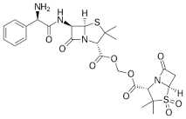
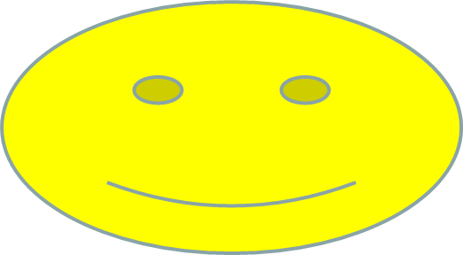
Trade: Unasyn
Generic: sultamicillin

Slide 35
Cephalosporins

Slide 36
Cephalosporins
    the first cephalosporin discovered (Cephalosporin C) had very poor antibiotic activity (about 1/1000th the activity of penicillin G)
    Cephalosporins (esp. 1st generation compounds) are generally not orally active
    They have similarly poor activity against Gram-(+) and Gram-(–) bacteria

Slide 37
Properties of Cephalosporin C
Disadvantages
Polar due to the side chain - difficult to isolate and purify
Low potency - limited to the treatment of urinary tract infections where it is concentrated in the urine
Not absorbed orally
Advantages
Non toxic
Lower risk of allergic reactions compared to penicillins
More stable to acid conditions
More stable to β-lactamases
Ratio of activity vs Gram -ve and Gram +ve bacteria is better
Conclusion
Useful as a lead compound

Slide 38
Structure – Activity Relationships
Similar to penicillins
The β-lactam ring is crucial to the mechanism
The carboxylic acid at position 4 is important to binding
The bicyclic system is important in increasing ring strain
Stereochemistry is important
The acetoxy substituent is important to the mechanism

Slide 39
Structure – Activity Relationships
Possible modifications
7-Acylamino side chain
3-Acetoxymethyl side chain
Substitution at C-7
7

Slide 40
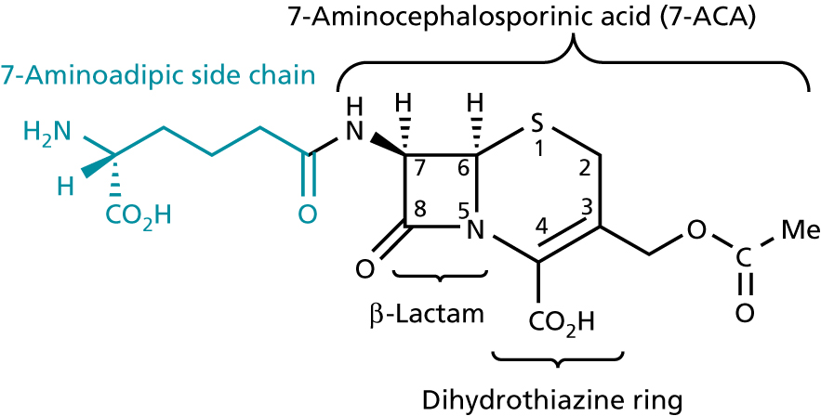
Structure – Activity Relationships
Despite the fact that cephalosporins are less-strained than penicillins, they are still quite reactive due to the double bond between C-3 & C-4 and the methyleneacetoxy group at C-3
If the double bond is moved to the 2,3 position, there is a significant loss in activity
The nature of the C-3 substituent is clearly important for activity

Slide 41
Mode of Action of Cephalosporins
  Cephalosporins are believed to have the same mode of action to penicillins (i.e. they bind to the bacterial trans-peptidase enzyme that forms the cross-linked peptidoglycan layer)
  As with penicillins, cephalosporins are susceptible to attack by β-lactamases (note that some β-lactamases seem to be more efficient at hydrolysing penicillins, whilst others are better at hydrolysing cephalosporins)
  Like penicillins, introduction of steric bulk in the near the sidechain amide of cephalosporins leads to β-lactamase resistance
  Allergic reactions are less common with cephalosporins than penicillins
  Cephalosporins do cause a few mild side effects, including nausea, vomiting & diarrhoea (due to disruption of normal flora)

Slide 42
Mode of Action of Cephalosporins
The acetoxy group acts as a good leaving group and aids the mechanism

Slide 43
First Generation Cephalosporins
    These compounds are primarily active against Gram (+) cocci & limited Gram (–) strains.
    Cephapirin
    For parenteral use only
    Resistant to Staph. β-lactamases, but
    susceptible to many others
    De-activated by endogenous esterases
    Good substitute for methicillin
    Cefazolin
    C-3 acetyl group replaced with thiadiazole (still good leaving group, but resistant to esterases)
    Longer half-life than cephapirin
    Causes less pain upon injection

Slide 44
First Generation Cephalosporins
    Orally active compounds
Cephalexin (R = H) & Cefadroxil (R = OH)
    Note similarity with ampicillin & amoxycillin
    Replacement of C-3 acetate with H
    eliminates metabolic deactivation, but
    also reduces potency
    The "ampicillin" sidechain does not appear to alter spectrum of activity, but does improve g.i. absorption
    Can be administered both orally and I.M.
    Limited activity against Gram (–) bacteria
Cephradine
    Note the hydrogenated aromatic ring
    This results in the ring being π-electron
    rich & planar, but not conjugated
    Has good acid stability
    Can be administered both orally and I.M.

Slide 45
Second Generation Cephalosporins
Cefuroxime
Has a cis-oriented methoxyimino group in the C-7 side chain
Results in significantly improved resistance to some β-lactamases due to steric bulk (the trans-analogue is not resistant)
    Cefoxitin
    Has an α-methoxy group at C-7
    Increased steric bulk leads to significant
    stability against many β-lactamases
    Improved activity against some anaerobic
    infections compared to other 2nd generation
Introduction of the carbamoyl group at C-3 results in intermediate metabolic stability (b/n OAc & thiazole)

Slide 46
Second Generation Cephalosporins
Orally Active Compounds
Cefaclor
Introduction of Cl at C-3 improves acid stability, allowing for oral administration
Also quite stable to metabolism
Less active against Gram (–) than most 2nd generation, but more active than 1st
Replacement of S with CH2 leads to more potent and more chemically stable compound
  Cefprozil
    Has a propenyl group at C-3, conjugated with the ring
    Although both trans- and cis-forms are
    active, the predominant trans-isomer is
    more potent against Gram (–) bacteria
    Slightly more potent than cefaclor

Slide 47
Third Generation Cephalosporins
    These compounds generally less active against staphylococci than 1st generation, but are much more active than both 1st & 2nd generation compounds against a broader range of Gram (–)
    They are particularly useful against nosocomial multidrug-resistant hospital acquired strains
    Structurally, these compounds are typified by heteroaromatic and oxime containing C-7 sidechains
    Cefotaxime (X = CH₂OAc)
    Significant β-lactamase resistance due to side chain
    Excellent Gram (–) activity
    C-3 acetoxy group vulnerable to degradation
    For parenteral use only
    Ceftizoxime (X = H)
    C-3 substituent completely removed (gives better
    metabolic stability)
    Other properties similar to cefotaxime

Slide 48
Third Generation Cephalosporins
    Orally Active Compounds
    Cefixime
    The C-7 sidechain cis-oximino acidic group
    leads to b-lactamase resistance
    C-3 vinyl group is similar to that in cefprozil
    Has excellent oral bioavailability
    Activity against Gram (–) bacteria is intermediate between 2nd & 3rd generation compounds
    Poorly active against staphylococci
    Ceftibuten
    Has a cis-ethylidinecarboxyl group at C-7,
    leading to enhanced b-lactamase resistance
    and improved oral bioavailibility
    No C-3 substituent, so more
    metabolic stability
    Mainly used for respiratory & ear infections

Slide 49
Fourth Generation Cephalosporins
    Generally these compounds have better broad spectrum activity
Cefepime
    The C-7 substituent gives broader spectrum of activity and increased resistance to β-lactamases
    Also has improved staphylococcus activity
    The quaternary N-methylpyrrolidine at C-3 appears to assist penetration into Gram (–) bacteria
    Several "next generation" cephalosporins are under development

Slide 50
Summary of Cephalosporins

Slide 51
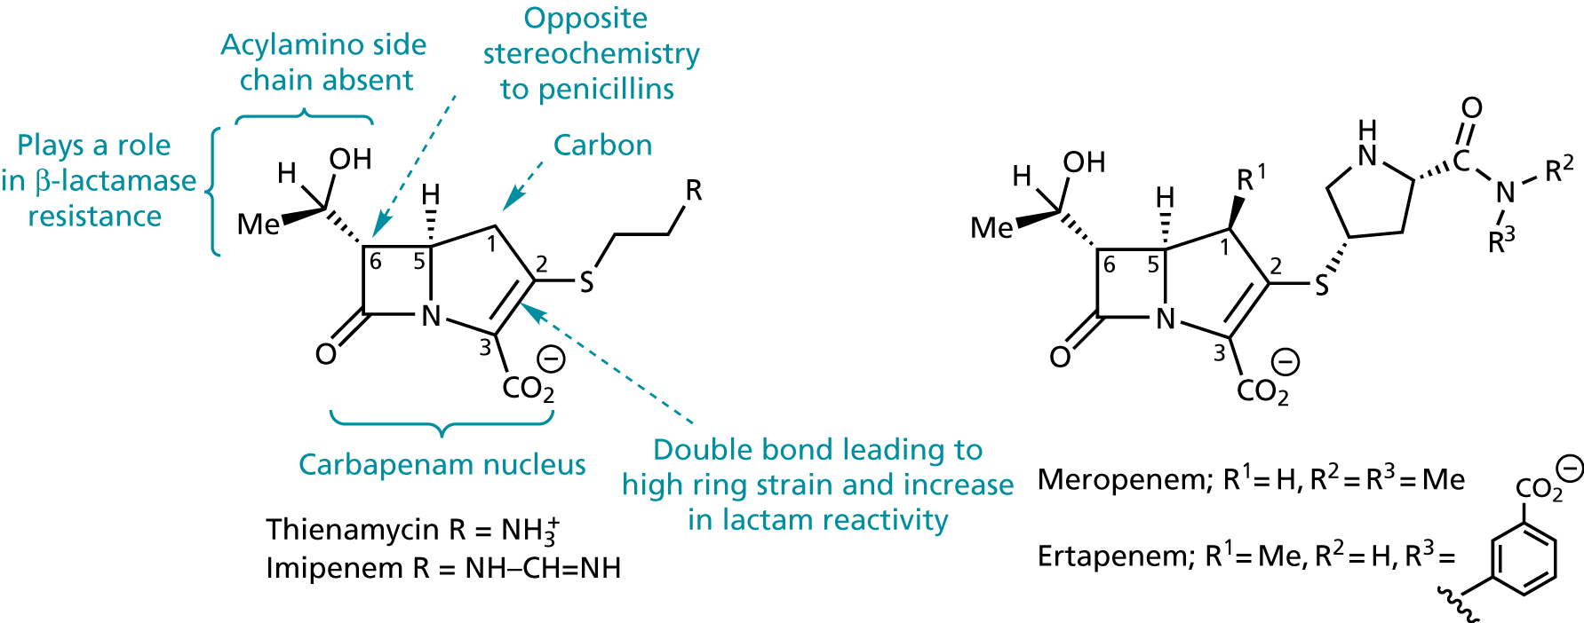
Other β-lactam Antibiotics
    Carbapenems
        Thienamycin
        Imipenem
        Meropenem
    They are potent, with an extraodinary braod range of activity against G(+) and G(-)

