Slide 1
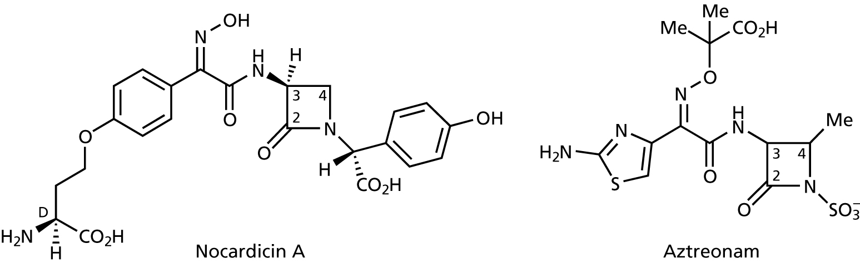
Othe β-lactam Antibiotics
    Monobactam
        Nocardicin A
        Aztreonam
    Monocyclic β-lactam have been isolated from natural sources
    They operate via a different mechanism from penicillins and cephalosporins
    There is some evidence supporting this in that these compounds are inactive against Gram positive bacteria

Slide 2
Inhibitors of Protein Biosynthesis
The major groups of bacterial protein synthesis inhibitors are the
  Aminoglycosides
  Tetracyclines
  Macrolides

Slide 3
Inhibitors of Protein Biosynthesis
    One of the major advantages of the β-lactam antibiotics is that they act on a process that does not occur in mammalian cells
    However, we have already seen that they are not the "ultimate" drugs
    For compounds that act as antibacterials by inhibiting ribosomal mediated protein biosynthesis, the issue of selectivity becomes important
    Selectivity is the key since eukaryotic organisms also use ribosomes to mediate their protein synthesis
    Selectivity with these drugs can be achieved because bacteria have different subunits (50S and 30S) in their ribosomes (the place where protein synthesis occurs) (note that mammals have 60S & 40S subunits)

Slide 4
Aminoglycosides
    These compounds all contain a 1,3-aminoinositol moiety, either streptamine, 2-deoxystreptamine, or spectinamine (polycations)
    The chemistry, spectrum of activity, potency, and pharmacokinetics of these compounds are determined by the arrangement of the above units as well as the substitution of the various hydroxyl groups
    Compounds in this class are generally water soluble, given I.M. or by perfusion (poorly absorbed orally)
    Have a broad-spectrum of antibacterial activity, but clinical use is usually limited to severe Gram (–) infections due to their toxicity

Slide 5
Mode of Action of Aminoglycosides
    These aminoglycosides are bactericidal (they kill bacteria) due to a combination of toxic effects
    At lower doses they cause a mistranslation of RNA templates, leading to the bacteria synthesising proteins that have no function
    Commonly this results in disruption of bacterial membranes
    At high doses of aminoglycosides, the initial disruption to bacterial membranes leads to the drug entering the bacterial cell in high concentrations, resulting in complete disruption to protein synthesis
    Bacterial Resistance
    This can occur, usually because the bacteria produce enzymes (R-factors) that modify (e.g. N-acteylate, O-phosphorylate) the aminoglycosides
Chemical deletion or modification of susceptible functional groups can lead to compounds that are still active

Slide 6
Examples of Aminoglycosides
Kanamycin
    Unstable to R-factor enzymes, being
    O-phosphorylated at C-3' and N-acylated
    at C-6', resulting in inactive drug
Amikacin
    Made from kanamycin A
    The amide attached to N-3 protects the
    compound from modification by R-factor
    enzymes at C-3' & C-6' (believed to be
    due to a decrease in binding affinity with
    R-factor enzymes), increase potency and broaden activity

Slide 7
Examples of Aminoglycosides
Gentamicin
    This is the most important aminoglycoside still in clinical use (used for life-threatening Gram (–) infections)
    The first antibiotic to show activity against Pseudomonas aeruginosa infections (frequently found in burns, pneumonias, urinary tract infections)
    Note that some of the sites for modification (= deactivation) by R-factor enzymes are absent in gentiamicin
    Still deactivated by modification at C-2', C-6', & C-1
When used in conjunction with β-lactam antibiotics, the two compounds react together (C-1 NH₂ is nucleophilic), thus deactivating both
Problem can be overcome by administering each drug in different tissues (e.g. one in each arm)

Slide 8
Examples of Aminoglycosides
    Streptomycin
    Introduced for the treatment of
    tuberculosis in 1943 (discovered
    by Selmon Waksman, awarded
    Nobel Prize in 1952)
    Bacterial resistance to streptomycin is via N-acylation & O-phosphorylation

Slide 9
Tetracyclines
  Tetracyclines are widely used (preferably orally) antimicrobial agents
  They are characterised by four linearly fused six-membered rings
  All clinically relevant tetracyclines can be represented by the following general structure:
7
6
5

Slide 10
Mode of Action of Tetracyclines
The tetracyclines are bacteriostatic
They bind to the 30S subunit of the ribosome, and inhibit the binding of tRNA to the aminoacyl site

Slide 11
Chemical Properties of Tetracyclines
  Tetracyclines are amphoteric substances (both acidic and basic)
  Chelation of ions is an important feature of the tetracyclines
  This feature means that tetracyclines are incompatible with ion-rich antacids and food rich in calcium
pKa ~ 3 (similar to acetic acid)

Slide 12

Chemical Properties of Tetracyclines
  The α-orientation of the C-4 dimethylamino group is essential for their activity
  However, the C-1 to C-3 tricarbonyl system allows for enolisation, involving loss of the C-4 hydrogen
  This process, which can occur under either basic or acidic conditions, leads to the epimeric 4β-dimethylamino substituted compound which is inactive
  The epimerisation is most rapid at about pH ~4, and the equilibrium mixture is about a 50:50 mix of the 4α- and 4β-dimethylamino products

Slide 13
Chemical Properties of Tetracyclines
  Under acidic conditions, the tetracyclines undergo a dehydration reaction, leading to inactive products
  The C-6 hydroxyl is tertiary and benzylic and, with H-5a being α, the groups are perfectly arranged (trans) for an antiperiplanar elimination to occur
  This process can happen even on storage, so older tetracyclines are normally discoloured (the dehydrated product is a deeper yellow than the parent)
  Some clinically useful tetracyclines do not have a C-6 hydroxyl, & are therefore free of this complication

Slide 14
Chemical Properties of Tetracyclines
  Under basic conditions (above pH ~ 8.5) the tetracyclines with a C-6 hydroxyl can decompose in a different way:
  The lactone product is inactive,
  Some tetracyclines have a Cl group at C-7 which makes them absorb visible light
  This can lead to the formation of a free
  radical, and can cause potentially severe
  sunburn in patients exposed to sunlight

Slide 15
Chemical Properties of Tetracyclines
Tetracycline
  6-Me and 6-OH
  => acid labile
  => short half-life
Doxycycline
  loss of 6 OH addition of 5-OH
  => stability in acids and bases
  => long biologic half-life
  good absorption from GI tract
  => smaller dose

Slide 16


Specific Tetracyclines
    Tetracycline
    The classic tetracycline, produced by
    fermentation (very cheap drug)
    Oral absorption is irregular
    Food & milk lower absorption by ~50%
    Minocycline
    Highly lipophilic, has excellent oral bioavailability & absorption (can be given once per day??)
    Does not have C-6 hydroxyl (= more stable)
    Broader spectrum of activity than most
    tetracyclines (esp. against Gram (+) )
    Does cause nausea, vertigo & ataxia
    Doxycycline
    Well absorbed orally without food (falls by 20% with food)
    Can be administered once per day??
    Does not have C-6 hydroxyl (= more stable)
    Does not cause as many gastrointestinal
    disturbances, so preferred by many doctors

Slide 18
Structure – Activity Relationships
    The tetracycline template can only be modified in a few places whilst retaining activity

Slide 19
Macrolide Antibiotics
    The term "macrolide" derives from the large lactone (cyclic ester) that is common to these antibiotics
    The clinically relevant members have two or more characteristic sugars attached to a 14-membered lactone
    one of the sugars normally has an amine group, which makes them overall weakly basic (pKa = 8) compounds
indicates where minor structural modifications are beneficial to activity

Slide 20
  Macrolide Antibiotics
  Bacterial resistance has developed, either through R-factor enzymes that modify their own ribosome such that macrolides bind less efficiently, or by an active efflux process whereby the drug is expelled from the cell
  Macrolides are chemically unstable in acid, due to internal cyclic ketal formation (which is why erythromycins are being replaced by “ketolides”)
  The acid sensitivity of erythromycin is due to the presence of two alcoholic groups (6 and 12) and ketone (carbonyl group) at position 9
  The cyclic ketal is believed to cause the gastrointestinal cramping
  The macrolides have a relatively narrow spectrum of activity, but are commonly used for patients who are allergic to penicillins

Slide 21
Newer Macrolide Antibiotics
  Two mothds of inceasing the acid stability of ethyromycin:
      Protect the hydroxyl group (methyl ether, Clarithromycin)
      Increase the size of the macrocycle to 16-memebered ring (azithromycin)
  Clarithromycin has the C-6 hydroxyl replaced with a methoxyl group (prevents internal cyclisation to form ketal)
  The cyclic ketal is believed to cause the gastrointestinal cramping
  Azithromycin has a bigger ring, resulting from insertion of an N-methyl group between carbons 9 and 10. The ketone at C-9 has also been removed.
  The larger ring and lack of ketone means that the cyclic ketal cannot form, giving a more acid stable drug
  Has improved activity against Gram (–) bacteria compared to earlier macrolides
Clarithromycin
Azithromycin

Slide 22
Macrolide Antibiotics – Ketolides
    These compounds were developed to overcome the problem of bacteria developing resistance to macrolides
    Telithromycin ("ketek") commenced clinical use in 2003, and is used for the treatment of community acquired pneumonia, acute bacterial exacerbation of chronic bronchitis, and acute sinusitus
This carbamate with a large aromatic group improves affinity for binding to 50S ribosomal subunit (about 10-fold greater affinity than erythromycins)
Methoxy group needed to prevent internal ketal formation at C-3 or C-9 keto groups (makes it more acid stable)

Slide 23
Sulfonamides
Sulfa drugs
Sulfanilamide (parent)
Sulfanilamides = Aniline substituted sulfonamides

Slide 24
Prontosil:
It was the first synthetic antibacterial agent
active in vivo against streptococcal infections in mice
It is a prodrug (inactive in vitro) but in vivo → sulfanilamide (active form)
Prontosil undergoes reductive activation in liver

Slide 25
Chemical Classification of sulfonamide
Aniline substituted
Non-aniline
Prodrug
CH₂
Sulfanilamide
Mafenide
Prontosil

Slide 26
SAR
Free NH₂ is essential for activity.
Removal of NH₂ → inactive compounds.
Shifting NH₂ gp to m- or o-position ► inactive compounds.
Phenyl group is essential
SO₂ must be directly attached to phenyl ring

Slide 27
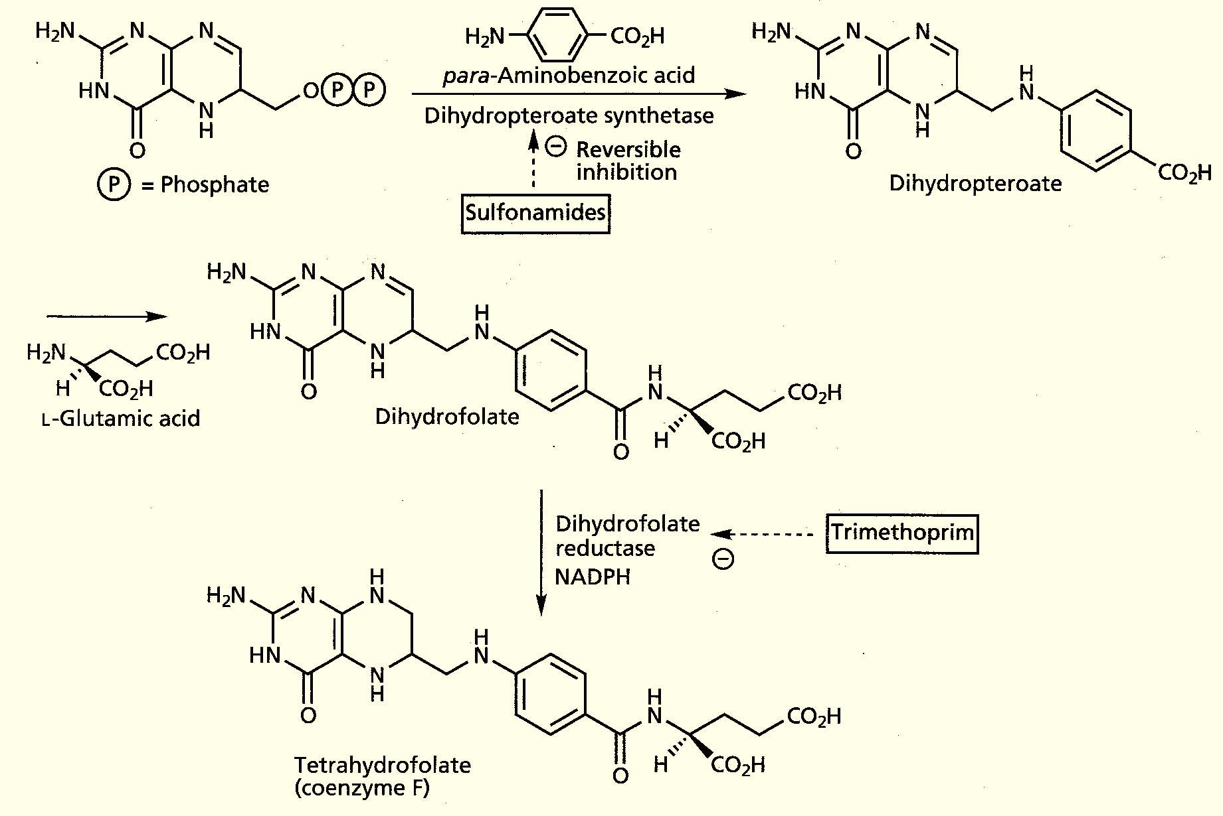
Mode of action of sulfonamides & Trimethoprime
    Sulfonamides act as competitive inhibitors of the enzyme dihydropteroate synthase, which is a crucial enzyme for bacteria since it is needed for the synthesis of folic acid

Slide 28
Inhibited by Sulfanilamide
Dihydropteroate
synthase
Dihydropetridine + PABA
Dihydropteroate
Inhibited by Trimethoprime
Dihydrofolate
Reductase
Dihydrofolic acid
DHFA
Tetrahydrofolic acid
THFA
Sulfonamides are bacteriostatic & classified as antimetabolites
Sulfonamides are inhibitors of Dihydropteroate synthase
Trimethoprime is competitive inhibitor for dihydrofolate reductase

Slide 29
HOW can sulfonamides inhibit dihydropteroate synthase??
They inhibit binding of PABA to dihydropteroate synthase resulting in enzyme inhibition (competitive antagonist)
isosteres
Both are isosteres (similar intratomic distances) & bonding interactions so sulfa occupy active site of dihydropteroate synthase & prevent binding of PABA

Slide 30

    The reason sulfonamides are effective is that they mimic p-aminobenzoic acid (PABA)
    Due to their similarity with PABA, it is not surprising that sulfonamides block the PABA binding site of dihydropteroate synthase

Slide 31
HOW can sulfonamides inhibit bacterial growth???
WHY sulfonamides have selective toxicity???
Susceptible bacteria are unable to take up folic acid & must synthesize it.
Folates are essential for the biosynthesis of thymidine, without which bacteria cannot multiply DNA.
In Humans folic acid is supplied in diet & they lack dihydropteroate synthase. Consequently, sulfonamides/Trimethoprime have selective toxicity.

Slide 32
Physicochemical properties of sulfa drugs
1- Amphoteric characters:
Sulfonamides react as acid with bases & react as base with acids
Solubility of sulfa drugs
In water: All sulfonamides are insoluble except the sodium salts
In alkali: all are soluble in except sulfaguanidine
In acids: all are soluble in acids.

Slide 33
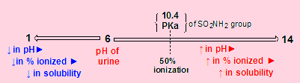
Crystallurea & PKa
Crystallurea: is the precipitation of sulfonamides as crystals in kidney which may cause kidney damage
pH of urine is ~ 6 and decrease in bacterial infection which lead to precipitation of sulfonamides in kidney → cause sever renal damage
N.B: pKa = pH at which 50% of the compound is ionized

Slide 34
HOW can we prevent Crystallurea???
Increasing urine flow (by drinking water)
Increasing pH of the urine (by using oral sodium bicarbonate)
Preparing derivatives with lower pKa (will not precipitate at urine pH)
Mixing different sulfonamides to achieve the total dose

Slide 35
Clinical classification of sulfonamides
(according to use)
1- Systemic sulfa
2- Intestinal sulfa
3- Ophthalmic sulfa
4- Sulfa for burn

Slide 36
1- Systemic sulfonamides:
Short-acting
Intermediate-acting
Long-acting
t_{1/2} 4-7 hours
t_{1/2} 10-12 hours.
t_{1/2} are 35-40 hours
Uses: UTI
N.B: long-acting sulfonamides used only under restricted medical supervision

Slide 37
2- Intestinal sulfonamides
Used in intestinal infections.
They are poorly absorbed from GIT ►► so they give a local effect .
Phthalyl sulfathiazole
Zwitter ionic
It is Zwitter ionic prodrug ► has poor absorption
Bacterial hydrolysis in the colon will slowly release the parent sulfathiazole

Slide 38
Sulfasalazine (salazopyrine®)
Used orally, although not absorbed in GIT
It is prodrug, undergoes reductive metabolism by gut bacteria, into sulfapyridine (antibacterial) + 5-aminosalicyclic acid (anti-inflammatory)
Uses: to treat ulcerative colitis and Crohn's disease.

Slide 39
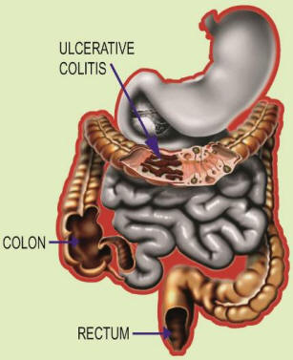
Inflammatory Bowel Disease
Include two categories:
Ulcerative colitis: It is characterized by inflammation and sores in the lining of rectum and colon Unfortunately, only symptomatic therapy present.
Crohn's disease: occur anywhere from mouth to the end of the rectum

Slide 40
3- Ophthalmic sulfonamides
Uses: in conjunctivitis, superficial ocular infections with Chlamydia trachomitis
They must be water soluble. e.g.: Sulphacetamide Na (Ocusul®)
Sulphacetamide Na
Water soluble
Short acting
Synthesis of Sulphacetamide

Slide 41
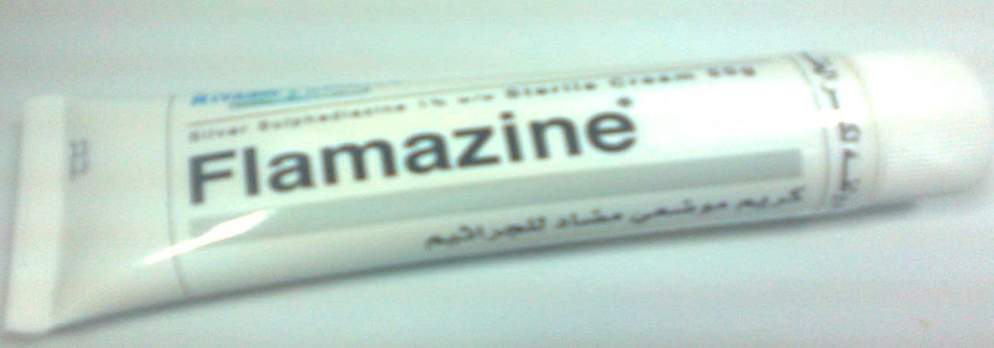
4- Sulfonamides for burn therapy
Silver sulfadiazine (Dermazine®)
It is very effective in burn therapy.
is effective against bacteria & fungi

Slide 42
Pediatric sulfonamides
Sulfisoxazole acetyl is tasteless prodrug, which accounts for its use in pediatric preparations.
Acetyl moiety is removed in the GIT, giving the active sulfisoxazole.

Slide 43
Pharmacokinetics
Has good absorption from GIT (EXCEPT ????)
excreted by the kidney.
The drugs are bound to plasma protein (sulfisoxazole, 30–70%) so they, may displace bilirubin.
This phenomenon disqualifies them for use in late term pregnancy as they can cause neonatal jaundice.

Slide 44
Metabolism Sulphacetamide:

Slide 45
Trimethoprim
MOA: inhibits dihydrofolate reductase enzyme
Uses: orally with or without sulfa in treatment of UTI
Trimethoprim + sulfonamide ► is a synergistic inhibition
Note
Sulfonamides alone are bacteriostatic
Sulfonamides + Trimethoprime are bactericidal

Slide 46
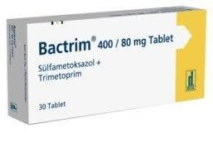
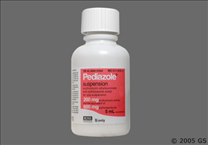
Combination therapy in sulfonamide
Combination |  | Target | Action | Notes
1 | Sulfonamide | DNA Synthesis | Together are bactericidal | Synergistic combination in URTI
 | Trimethoprime
2 | Erythromycin | Protein | 2 bacteriostatic | Very popular in URTI
 | sulfisoxazole acetyl | DNA
Combination No. 1: (Bactrim®). is the most commonly used in a 1:5 fixed concentration ratio (Trimethoprime/sulfamethoxazole)
It is not only synergistic but also is less likely to induce bacterial resistance
Combination No 2. is taste less used commonly in pediatrics

Slide 47
Nucleic Acid Biosynthesis Inhibitors Antibiotics
(Quinolones)
First generation Quinolones
Nalidixic acid: (Negram®)
Chemical name:
1-Ethyl-7-methyl-4-oxo-1,4-dihydro-[1,8]naphthyridine-3-carboxylic acid
It is the lead compound of first generation Quinolones.
Rapidly excreted in urine after oral administration.
Treatment of renal Gr -ve infections, (Usually E. Colli).

Slide 48
Disadvantages of Nalidixic acid
  Narrow spectrum [active against Gr-ve only)
  Not suitable for systematic infections [due to rapid elimination by kidney ►↓ short t_{1/2}]
  Rapid development of bacterial resistance.

Slide 49
Second generation Quinolones
Norfloxacin (noracin®) | Ciprofloxacin | Ofloxacin
ttt of UTI & gonorrhea | UTI | UTI
 | Respiratory & anti-TB | Respiratory inf. & anti-TB
 |  | Levo isomer (Levofloxacin) is 8-125 times more active than the dextro
F atom ► ↑ potency # Gr +ve bacteria
piperazine moiety ↑ antipseudomonal activity.
Ofloxacin (racemic mixture) is 2nd generation & its levo isomer is 3rd generation

Slide 50
Third generation Quinolones
Sparfloxacin
has higher potency against Gr +ve & –ve bacteria.
It has a long elimination half-life of 18 hr (used once-a-day).
Levofloxacin
Levo isomer of ofloxacin is 8-125 times more active than the dextro

Slide 51
Biological classification of quinolones :
Generation | 1st | 2nd | 3rd | 4th
e.g. | Nalidixic Acid | Norfloxacin Ofloxacin Ciprofloxacin | Levofloxacin Sparfloxacin | Trovafloxacin
Administration | Oral | Oral & I.V.
bioavailability | Low | High
Spectrum | Gr -ve | Gr –ve & +ve
UTI | uncomplicated | complicated
systemic infection | not | used
P aeruginosa | - | +
Third generation have long t_{1/2} & used Once-daily dosing
Fourth generation are active against Aerobic & Anaerobes

Slide 52
MOA
  These compounds are bacteriocidal, and inhibit DNA gyrase & topoisomerase IV (key enzymes that control the shape of DNA, resulting in DNA that cannot be used)
Selective toxicity
much higher concentrations of fluoroquinolones is required to inhibit human topoisomerase II than that required for bacterial enzymes

Slide 53
SAR
These three groups are essential for binding to the active site in enzymes
They are the pharmacophoric groups

Slide 54
Substitution at position 6 & 7 modify the spectrum of activity e.g.
F atom at C6 increase activity # Gram +ve .
Piperazinyl gp at position C7 increases antipseudomonal activity

Slide 55
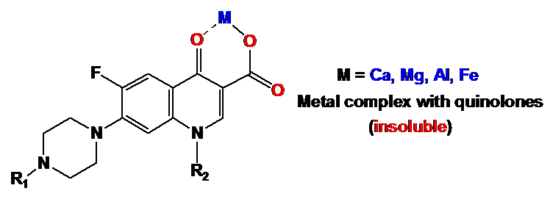
Why??
Quinolones are contra-indicated with Ca, Mg, Fe nutrition or with milk
Chemical Incompatibilities to quinolones
quinolones chelate heavy metals (Ca²⁺, Mg²⁺, Al³⁺ & Fe²⁺)
Give less water-soluble complexes
↓ absorption
↓ bioavailability & ↓ potency

Slide 56
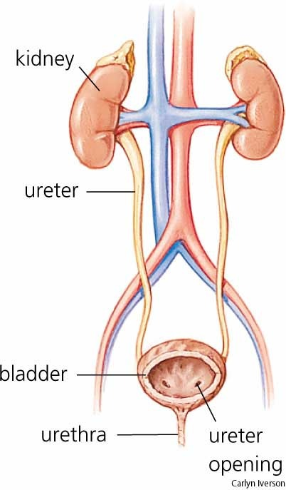
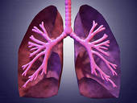
Therapeutic uses
UTI
Cystitis
URTI
Anti-TB

Slide 57
Quinolones- SARs
  Carboxy-4-pyrido-4-one is the pharmacophore
  Carboxylic acid and ketone are involved in binding to DNA gyrase enzyme
  Reduction of the 2,3-double bond ➔ inactive molecule
  Reduction of the ketone ➔ inactive molecule
  substitution at C2 ➔ reduce activity (reduce affinity)
  Fluoro substitution AT C6 ➔
    GREATLY improves antimicrobial activity (by increasing lipophilicity ➔ increase penetration the bacterial cell wall)
    Increase the DNA gyrase inhibitory action

Slide 58
Quinolones- SARs
  An additional Fluoro substitution at C8 ➔ improves antimicrobial activity (by increasing lipophilicity ➔ increase penetration the bacterial cell wall)
  Heterocyclic substitution at C7 ➔ improves the spectrum of activity (specially Gram-negatice)
    Piperazinyl ➔ ciprofloxacin
      increase binding to CNS and GABA receptors ➔ CNS side effects
      Substitutions on the Piperazinyl ring ➔ reduce this CNS side effect (eg. Ofloxacine)
    Pyrrolidinyl ➔ moxifloxacin

Slide 59
Quinolones- SARs
  Substitutions at N-1 ➔ broaden activity, change potency
    Alkyl (Cyclopropyl) ➔ broaden activity to include atypical bacteria and Chlamydia
    Aryl ( 2,4-difluorophenyl) ➔ give the best activity (eg. Trovafloxacine)
http://sitemaker.umich.edu/medchem/medchemlibrary/lectures_-_412

Slide 60
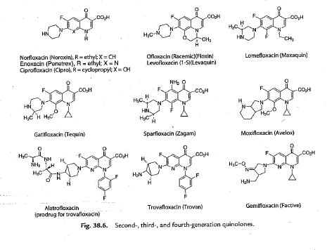
Other Antimetabolites – Quinolones

Slide 61


Quinolones- SARs

Slide 62
Antibacterials Act Against Cell Metabolism
(Antimetabolites)
“Interference with Folate Metabolism”
http://sitemaker.umich.edu/livingtextbook.mc412/sulfonamides

Slide 63
Antimetabolites
(interference with the folate synthesis)
Bacteriostatic rather than bactericidal
  Two mechanisms:
Sulfonamides
  Interfere with folate synthesis (false PABA)
  eg sulfacetamide, sulfadiazine, sulfamethizole, sulfamethoxazole, sulfasalazine
Pyrimidines
  Dihydrofolate reductase inhibitors (DHFRIs)
    ie transformation of (DHFA) FAH₂ ➔ (THFA) FAH₄ cannot occur
  eg trimethoprim, pyrimethamine

Slide 64

Sulfonamides-Introduction
    Sulfonamides were discovered in the 1930's
    They are antimetabolites (i.e. they inhibit bacterial metabolism) and are bacteriostatic (they do not kill bacteria)
    The first sulfonamide was prontosil, a red dye, that interestingly has activity in vivo but not in vitro
    It was soon established that prontosil was in fact a pro-drug, being metabolised in the liver to sulfanilamide (this discovery led to the awarding of the Nobel Prize for medicine in 1938)
    Sulfonamides are not widely used today (despite being relatively cheap), primarily due to their lack of effectiveness against some common bacteria and the fact that their metabolic products are sometimes toxic

Slide 65
Sulfonamides – Mechanism of Action
    Sulfonamides act as competitive inhibitors of the enzyme dihydropteroate synthase, which is a crucial enzyme for bacteria since it is needed for the synthesis of folic acid
    Inhibition of dihydropteroate synthase has no effect on humans, since we acquire our folic acid from food
    Folic acid is the bacterial precursor of tetrahydrofolate which is used by bacteria in their biosynthesis of nucleic acids
Show how folic acid is used as a building block for DNA??

Slide 66
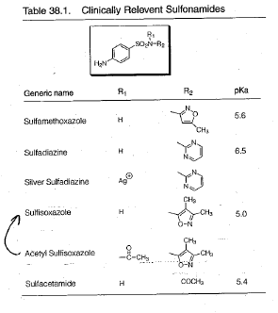
Sulfonamides – SARs
Foye, page 1038

Slide 67
Sulfonamides - Structures
    Generally, the incorporation of heteroaromatic groups (electron withdrawing) on the sulfonamide nitrogen results in compounds with both improved efficacy and also improved water solubility
    The poor water solubility of some of the earlier sulfonamides used clinically, led to a problem called "crystalluria" (crystalisation of the drug in the urine)
    This led to kidney damage, although the problem could be partially prevented by drinking plenty of water
    Sulfisoxazole and sulfmethoxazole are still used clinically, generally for the treatment of urinary tract infections

Slide 68
Sulfonamides - Sulfasalazin

Slide 69
Other Antimetabolites-Trimethoprim
    In the pathway leading from dihydropteroate diphosphate to folic acid, bacteria use a second enzyme (dihydrofolate reductase) to generate tetrahydrofolic acid
Trimethoprim

Slide 70
Other Antimetabolites-Trimethoprim
    Trimethoprim is an inhibitor of dihydrofolate
    reductase (DHFR), and is bacteriostatic
    Importantly, humans also need DHFR, in
    order to degrade consumed folic acid to
    tetrahydrofolic acid (required for the synthesis
    of purine, ultimately leading to DNA synthesis)
    However, trimethoprim is selective for bacterial DHFR, since there is a slight difference in the tertiary structure of DHFR from bacteria & humans
    Trimethoprim is 100,000 times more effective against bacterial DHFR
    Trimethoprim alone can be used for the treatment of uncomplicated urinary tract infections
    More commonly, trimethoprim is used in conjunction with sulfamethoxazole (1:5 ratio) for the oral treatment of urinary tract infections, MRSA, otitis media, legionella, shigellosis, bronchitis, and traveller's diarrhoea
MRSA: Methicillin-resistant Staphylococcus aureus

