Slide 1

Polarography
By
Prof. Sayed Derayea
Faculty of Pharmacy
Minia University

Slide 2
Electrochemical methods of analysis
Bulk methods
Conductimetry
Interfacial methods
Dynamic methods
Controlled current
Controlled current coulometry
controlled potential
Fixed potential
Controlled potential coulometry
Amperometry
Variable potential
Voltammetry
Polarography
Static methods
Potentiometry
Hydrodynamic voltammetry

Slide 3
Definition
Polarography is a type of voltammetry in which
  the working microelectrode is the dropping mercury electrode (DME) and
  the counter electrode is a mercury pool.
Convection effects can be minimized by using unstirred solutions during current measurements

Slide 4
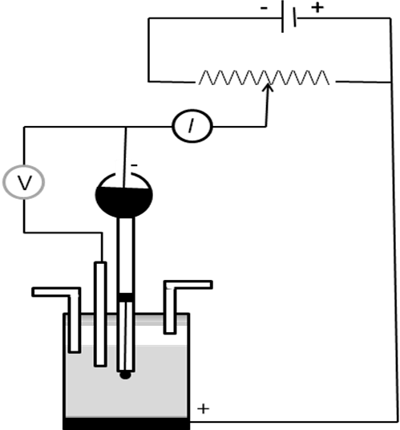
Classical polarograph
Variable resistor
DME
Reference electrode
Nitrogen outlet
Nitrogen inlet
Analyte solution
Mercury pool

Slide 5
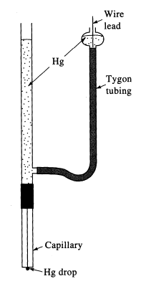
Dropping Mercury Electrode (DME)

Slide 6
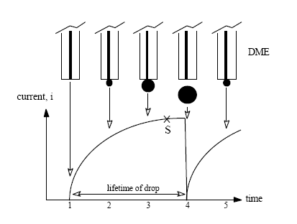
Drop life and observed current

Slide 7
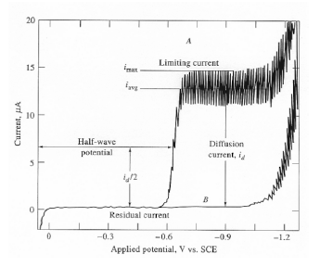
Polarogram

Slide 8
Ilkovic equation
I_{d} = 607 nD^{1/2}C m^{2/3} t^{1/6}
i_{d} = diffusion current, μA
n = number of electrons
D = diffusion coefficient of analyte, cm² s⁻¹
C = concentration of analyte, mM
m = mass of mercury flowing through capillary tip, mg s⁻¹
t = drop life, s

Slide 9
Advantages of mercury drop electrode
High overpotential for the reduction of H₃O⁺
Reproducible dropping action
Formation of an amalgam with several metals
Electrode surface is continuously renewed.
Easy calculation of surface area.

Slide 10
Disadvantages
Mercury is easily oxidized.
Low sensitivity (10⁻⁵ M).
Difficulties in its use
Mercury toxicity.

Slide 11
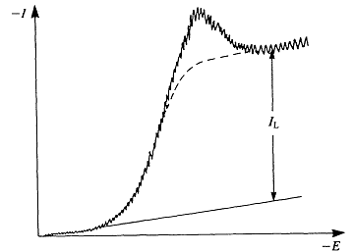
Polarographic maxima
Polarographic maximum

Slide 12
Minimization of polarographic maxima
The maximum may be reduced or completely removed by adding a maximum suppressor.
This is usually a simple gelatinous material (for example Triton X-100 or gelatin) that greatly slows down the migration of analyte ions to the surface of the electrode.
The accumulation of analyte ions is greatly reduced and the maximum in the polarogram is suppressed.
Care must be taken to avoid adding excess of these maxima suppressor, because they can change the solution viscosity and reduce the magnitude of the diffusion current.

Slide 13
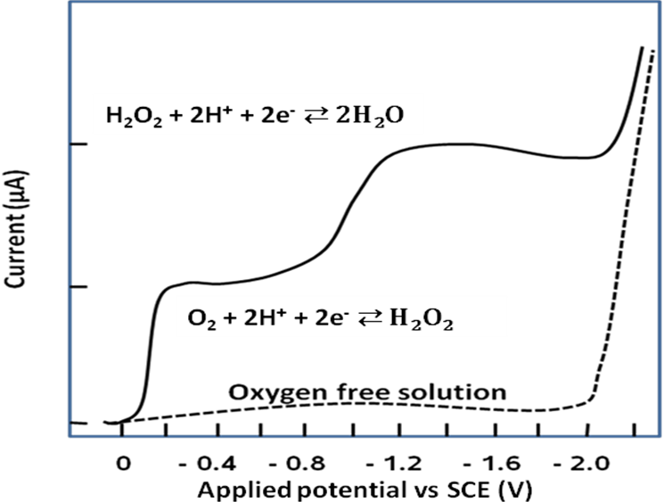
Oxygen waves

Slide 14
Origin of oxygen waves
The first wave
O₂ + 2H⁺ + 2 e⁻ ⇄ H₂O₂ (in acidic medium)
O₂ + 2H₂O + 2 e⁻ ⇄ 2H₂O₂ (neutral/alkaline)
The second wave
H₂O₂ + 2H⁺ + 2 e⁻ ⇄ 2H₂O (in acidic medium)
H₂O₂ + 2 e⁻ ⇄ 2OH⁻ (in alkaline medium)

Slide 15
Removal of oxygen waves
Physically by bubbling inert gas.
Chemically by addition of hydrazine
N₂H₄ + O₂ →N₂ + 2H₂O

Slide 16
APPLICATIONS OF POLAROGRAPHY
Inorganic applications
Most metal ions (reduced)
Mixtures of electro-active ions may
∆E_{1/2} >= 0.4 Volt for singly charged ions
0.2 Volt for doubly charged ions
Inorganic anions.
Dissolved oxygen in solution.
Oxidation states of a metal in solution.

Slide 17
APPLICATIONS OF POLAROGRAPHY
Organic applications
Most of the reducible organic substances (aldehyde, ketons, acids, nitro , etc. )
Easily oxidizable organic substances
Notes:
Careful selection of solvent
pH should be controlled.

Slide 18
Selection of the solvent
solvent :-
  must be able to dissolve a supporting electrolyte and the analyte,
  should not be reduced easily, and
  if necessary be buffered.
  Further, it must conduct electricity.
The most popular being water.
To dissolve organic compounds in water, a second solvent, such as ethanol, acetone, acetonitrile, acetic acid or dioxane, may first be mixed with water.

Slide 19
pH control of the solution
The pH of the solution should be control with a buffer.
This is because of the reduction of organic substances usually involves the reduction of a hydrogen on the molecule.
In this case, the buffer serves as the supporting electrolyte.
The usual choice for the analysis of simple organic pharmaceuticals would be an aqueous alcoholic (e.g. 80% buffer-20% methanol) solution containing a simple salt as supporting electrolyte (e.g. at least 0.01 M potassium chloride)
Simple buffer solutions are effective over narrow pH ranges, but mixed buffer systems, e.g. Britton-Robinson buffer, are more versatile when the polarographic behaviour of an organic species is be fully investigated.

Slide 20
Careful choice of buffer
Care must be taken to ensure that
no ions in the electrolyte interact with the analyte
pH changes do not affect its stability, and that
the use of aqueous/alcoholic solvents does not cause changes in
  the E_{1/2} of the electroactive species,
  the limiting current values, or
  the reduction mechanism involved, which might lead to errors in the analysis.

Slide 21
Some functional groups reducible in polarography.
Imines Dienes`` Oxime
Alkynes Nittiles Ketones
Diazocompound. Aldehydes
Nitroso compound. Halides Sulphones
Thiocyanates Sulphonium salts Heterocycles
Nitro compounds Organometalics
Dizunium salts Aromatic carboxylic acids
- The products of polarographic reduction may not be the same as if the reduction were attempted chemically,
- The reason is that the electrode kinetics limit the progress of multi-stage reactions.

Slide 22

Nitrofurans and nitroimidazoles
Nitrofurantoin, Metronidazole and Tinidazole

Slide 23
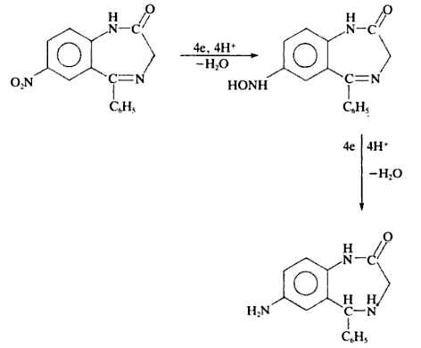
Benzodiazepines determination
solvent for reduction of Nitrazepam in 20% methanol-0.1M hydrochloric acid,
This gives peaks at -0.11 V and -0.67 V vs silver-silver chloride.

Slide 24
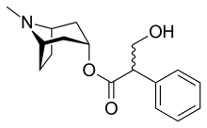
Atropine determination
It isexample for the use of chemical derivatisation in polarography
he analysis of atropine by d.c. polarography may be quoted, in 0.1 M tetrabutyl ammonium perchlorate in acetonitrile can be used as solvent.
Nitration of atropine can be effected by reaction at room temperature with 10% potassium nitrate in concentrated sulphuric acid, and a sensitivity of 200 ng atropine ml-L of 1 M sodium hydroxide supporting electrolyte with dpp

